Slide 1
Module1_Part4 Textbook : Operating Systems Concepts by Silberschatz
Operating SYSTEMS

Slide 2
Types of system calls
Process control
create process, terminate process
end, abort
load, execute
get process attributes, set process attributes
wait for time
wait event, signal event
allocate and free memory
locks for managing access to shared data between processes

Slide 3
Types of system calls
File management
create file, delete file
open, close file
read, write, reposition
get and set file attributes
Device management
request device, release device
read, write, reposition
get device attributes, set device attributes
logically attach or detach devices

Slide 4
Types of System calls
information maintenance
get time or date, set time or date
get system data, set system data
get and set process, file, or device attributes
Communications
create, delete communication connection
send, receive messages
From client to server
shared-memory model create and gain access to memory regions
attach and detach remote devices

Slide 5
Types of System calls
Protection
control access to resources
get and set permissions
allow and deny user access

Slide 6
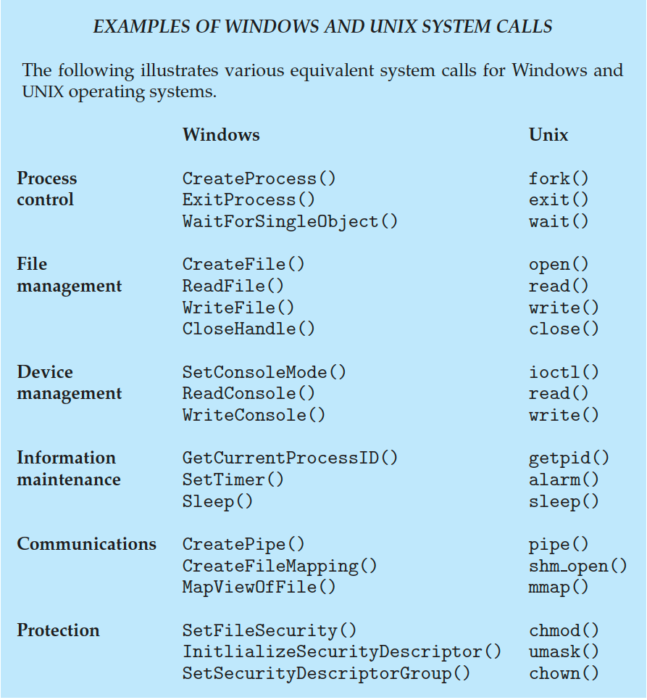
Examples of Windows and Unix System Calls

Slide 7
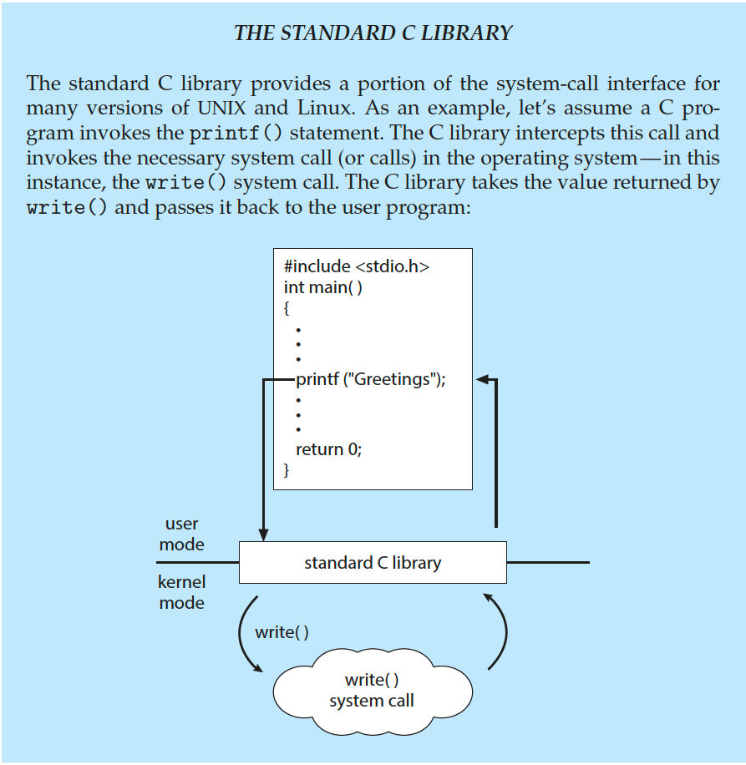
Standard C Library Example
C program invoking printf() library call, which calls write() system call

Slide 8
Important System Calls Used in OS
wait()
In some systems, a process needs to wait for another process to complete its execution. This type of situation occurs when a parent process creates a child process, and the execution of the parent process remains suspended until its child process executes.
The suspension of the parent process automatically occurs with a wait() system call. When the child process ends execution, the control moves back to the parent process
fork()
Processes use this system call to create processes that are a copy of themselves. With the help of this system call ,parent process creates a child process, and the execution of the parent process will be suspended till the child process executes.
exec()
This system call runs when an executable file in the context of an already running process that replaces the older executable file. However, the original process identifier remains same as a new process is not built, but stack, data etc. are replaced by the new process.

Slide 9
Important System Calls Used in OS
kill():
The kill() system call is used by OS to send a termination signal to a process that urges the process to exit.
exit():
The exit() system call is used to terminate program execution. Specially in the multi- threaded environment, this call defines that the thread execution is complete. The OS reclaims resources that were used by the process after the use of exit() system call.

